Slide 2
What is the Statewide Network of Agency Photos (SNAP)?
MSP’s statewide central repository
SOS database copy, mug shot photos , and MDOC photos
Mug shot photos are submitted via Live Scan by participating agencies at the time of arrest
All but 3 counties across the state are contributing images to the central repository

Slide 3
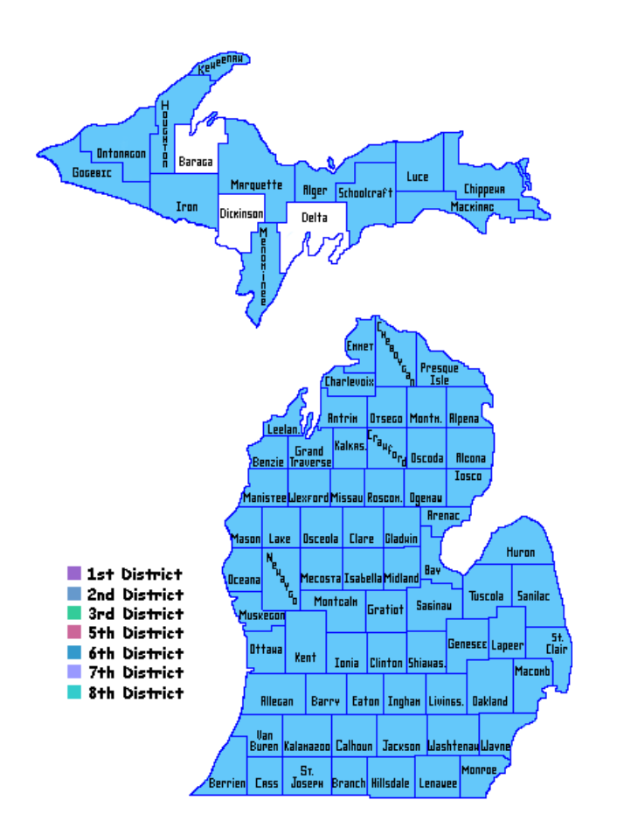

Slide 4
SNAP Database
>11.5 million criminal images (Front and Side View, SMT)
Greater than 5 million templated front facing images
>313 thousand templated MDOC images
>49 million templated SOS images (>12 million unique)

Slide 5
SNAP Unit
Staff
2 trained digital image examiners and 2 trained supervisors
Work in conjunction with the Audio Video Analysis Section
Training: minimum 80 hours of facial comparison and identification
Federal
Private
In-house
Examiners
Study the effects of aging, cosmetic surgery, and weight gain
Utilize 3D pose correction software to enhance images
Conduct FR searches and morphological comparisons
Provide Investigative Lead Reports to law enforcement
Testify in court
Peer and supervisory review
Follow the ACE-V (Analysis, Comparison, Evaluation, Verification) Method when completing morphological comparisons

Slide 6
SNAP Unit Services
Facial Recognition/Morphological Comparison
Investigative Lead Reports
Mobile Facial Recognition Administration
DHS HSIN Multi-State Facial Recognition Platform
Image Enhancement
Accessory Removal
3-D Pose Correction
Post-Mortem clean-up/enhancement
Watchlist
Photo Lineups
Image Analysis Team (IAT) – Fraud
Vulnerable & Impaired Persons Repository

Slide 7
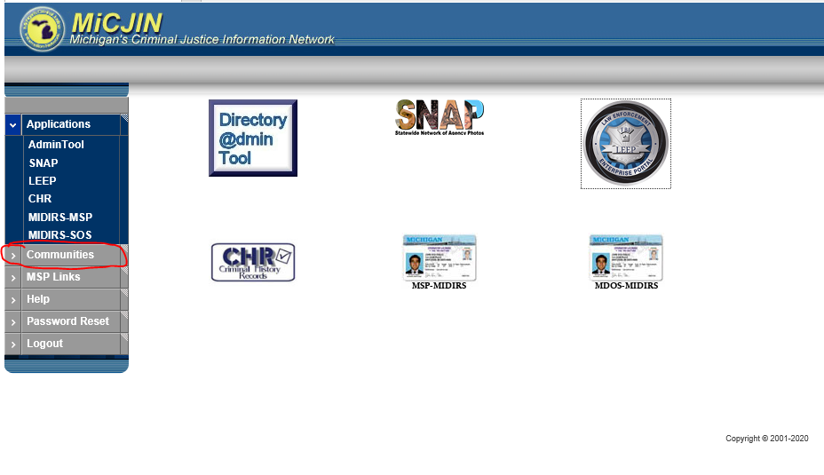
This is where you can find the SNAP Acceptable use policy, FAQs and other helpful documents. These are L/E sensitive and cannot be released to the public without prior MSP Approval.

Slide 10
Important considerations in FR
You can be subpoenaed if you run a facial recognition search.
Be prepared to explain your training and the FR process your department follows.
Logging search history in a database is recommended.
Logging/maintaining lead reports from MSP is recommended.
Make note of any edits/enhancements you have done to an image.
Standardized Investigative lead reports, peer review process, and supplemental reports recommended.
Current/Pending legislation regarding the use of facial recognition.
Ensure that you are entering all required fields.
Review and ensure you are following the SNAP Acceptable Use Policy.

Slide 11
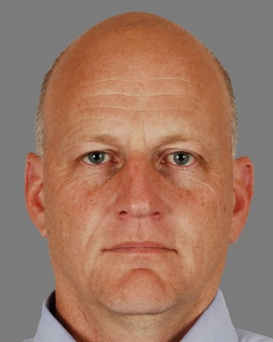
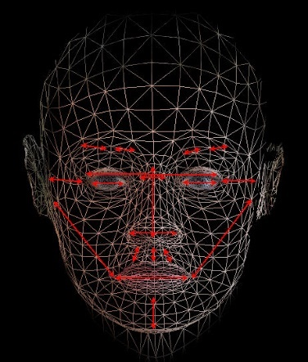
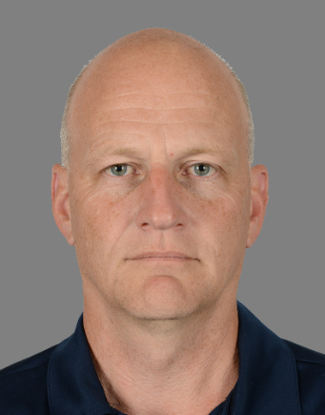
What is Facial Recognition?
Facial Recognition (FR) is the automated searching of a facial image in a biometric database, typically resulting in a group of facial images ranked by computer-evaluated similarity.
Facial Identification (FI) is the manual examination of the differences and similarities between two facial images or a live subject and a facial image (one to one) for the purpose of determining if they represent the same person.
An algorithm utilizes measurements and patterns of the face to create a template. It is this template that is searched against all other templates within the SNAP database.
Neither FR or FI get the best results alone. Maximum accuracy is achieved with a collaboration between the two (2018 NIST comprehensive examination).
Probe Image
Facial Template
Viable Candidate

Slide 12
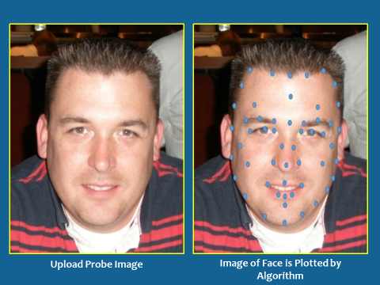
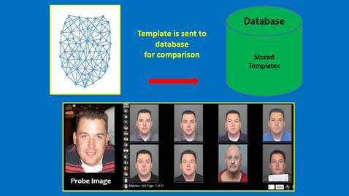
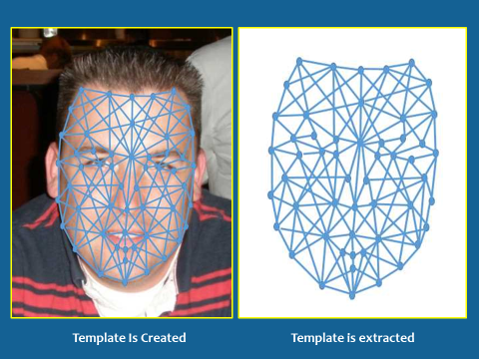
Step 1
Step 3
Step 2

Slide 13
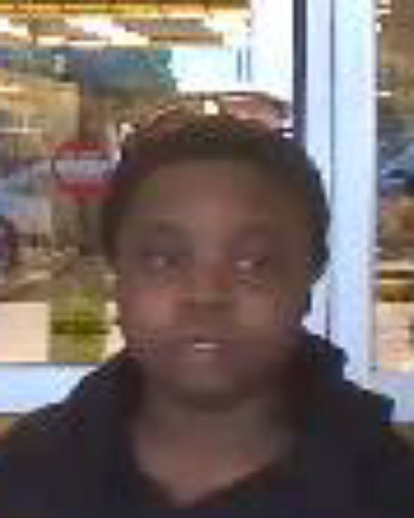
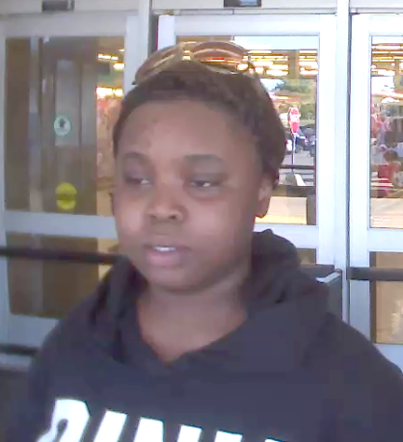
Best Practices for Images/FR Success
Camera placement
Eye level- above or below negatively effects the facial template
Resolution and Compression
QUALITY TRUMPS QUANTITY!
Highest resolution possible to reduce image compression
Compression can remove data that is there and add data that isn’t
Lighting
Over and under exposure
Back and overhead
Improper image extraction
FR unsuccessful
Proper image extraction
FR successful

Slide 14
Image extraction and image quality matter!
One image of suspect hit in position 33; probe was not clear enough for comparison
Four images of suspect hit in positions 1, 3, 26 and 61; probe was suitable for comparison

Slide 15
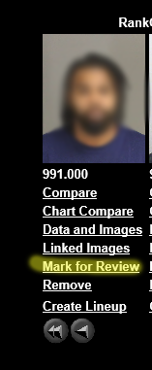
Running an FR Search
A valid case number and file class are REQUIRED to run any facial recognition search.
Please enter the name of the requesting officer in the “requestor” box.
Check “marked for review” on your candidate image.
One individual (multiple photos of same individual are OK) per session.
Do not delete sessions after you have entered a probe photo and run a search.

Slide 16
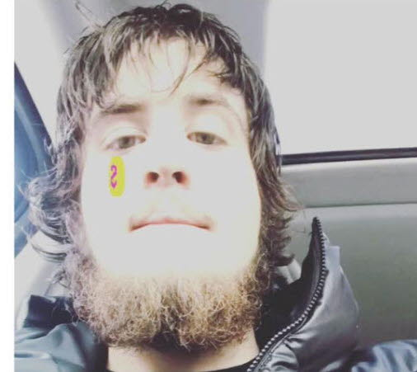
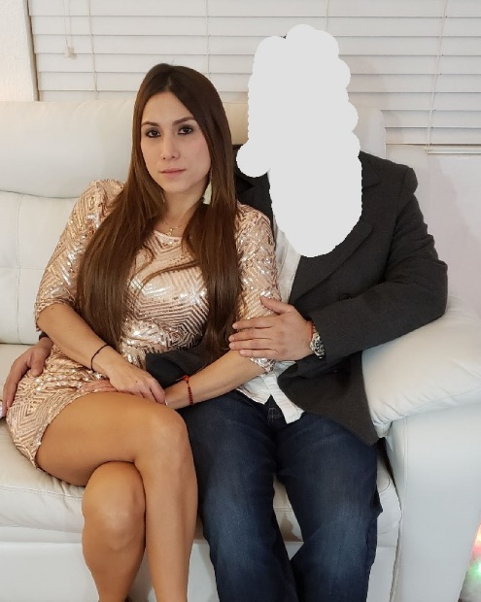
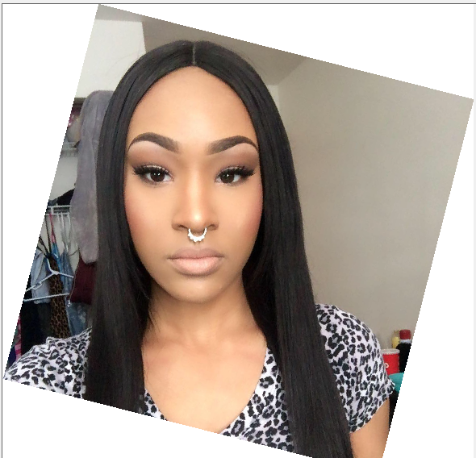
Be mindful of filters and their effects
Cover faces of additional people in photos
Rotate photo if face is at an angle
Flip photos taken as “selfie”

Slide 17
Investigative Lead Reports
Any Investigative Lead Report provided to you by the MSP SNAP Unit is NOT positive identification, is NOT probable cause for arrest, and further investigation MUST take place.
This is the same for any lead produced by a local agency.
All MSP Investigative Lead Reports are peer and/or supervisor reviewed prior to release.
It is recommended that local agencies peer/supervisory review as well.
As stated on the Investigative Lead Report, the reports contain Personally Identifiable Information and Law Enforcement sensitive information. These reports shall not be shared without a proper FOIA request and redaction of Personally Identifiable Information.

Slide 18
Investigative Lead Reports
Do not use the word “Match” to describe your finding as a result of FR/FI.
Viable candidate, investigative lead.
Be clear in your response that this is not a form of positive identification and should NOT be treated as such.
Do not run a photo if you are not confident in your ability to compare details of the face.
Can you testify in court to your findings regarding facial identification in detail?
Do not run a photo without a valid case number and identified law enforcement purpose regardless of urgency.

Slide 19
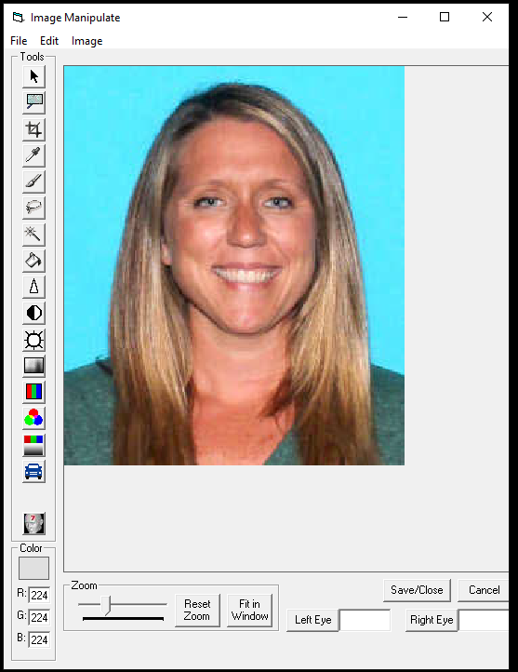
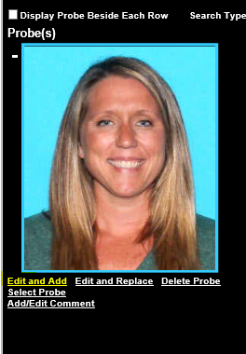
Image editing tools within SNAP

Slide 20
Compliance Checks
When you are clicking “OK” on the SNAP main page, you are agreeing to follow the acceptable use policy.
Monthly audits are performed.
Complete the compliance document and provide the necessary information (report/complaint number, file class/description).
All deleted sessions, sessions with multiple individuals, and sessions with poor quality probe images, are subject to targeted audit.
Continued violation WILL result in loss of access.

Slide 21
Continuing Education & Training
“You are always a student, never a master. You have to keep moving forward.” – Conrad Hall
As technology advances & legislation changes FR process, continuing education is critical for facial examiners.
Attending conferences (IAI, Idemia, Etc.)
Trainings offered by I3 & Idemia
LEVA Courtroom Testimony Training
Participation/membership in FISWG, OSAC
Advance facial examiner courses and proficiency testing .
Internal trainings, exercises, etc.

Slide 22
Facial Recognition Successes

Slide 23
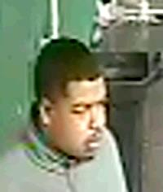
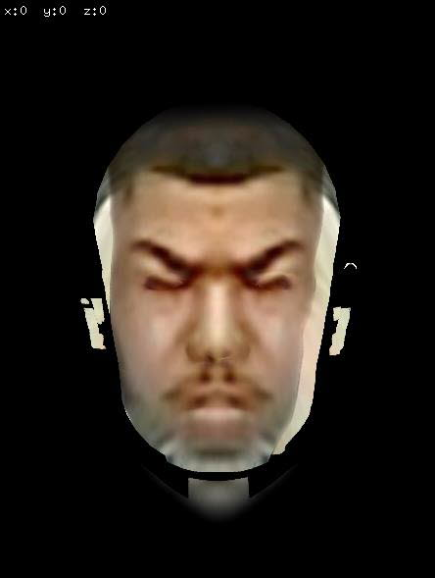
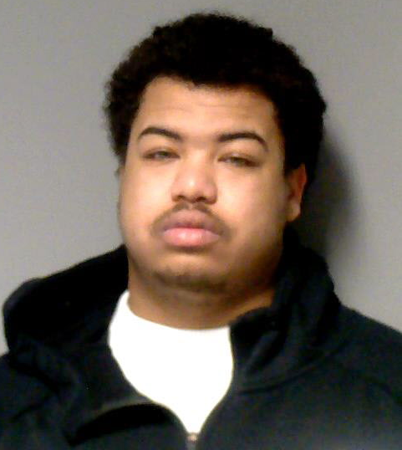
Probe image provided
(extracted by AVAU)
3D rendering of probe image
Viable candidate
Witness to assault with intent to murder
Notes:
Subject captured on CCTV, still image extracted, 3D image, hit.

Slide 24
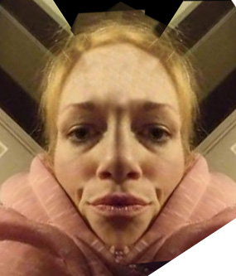
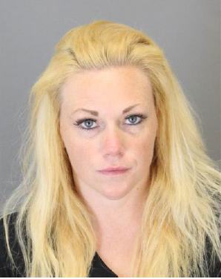
Felonious Assault
Probe Image: Half of face (Photoshop Mirroring)
Probe image provided
Photoshop mirroring
Viable candidate

Slide 25
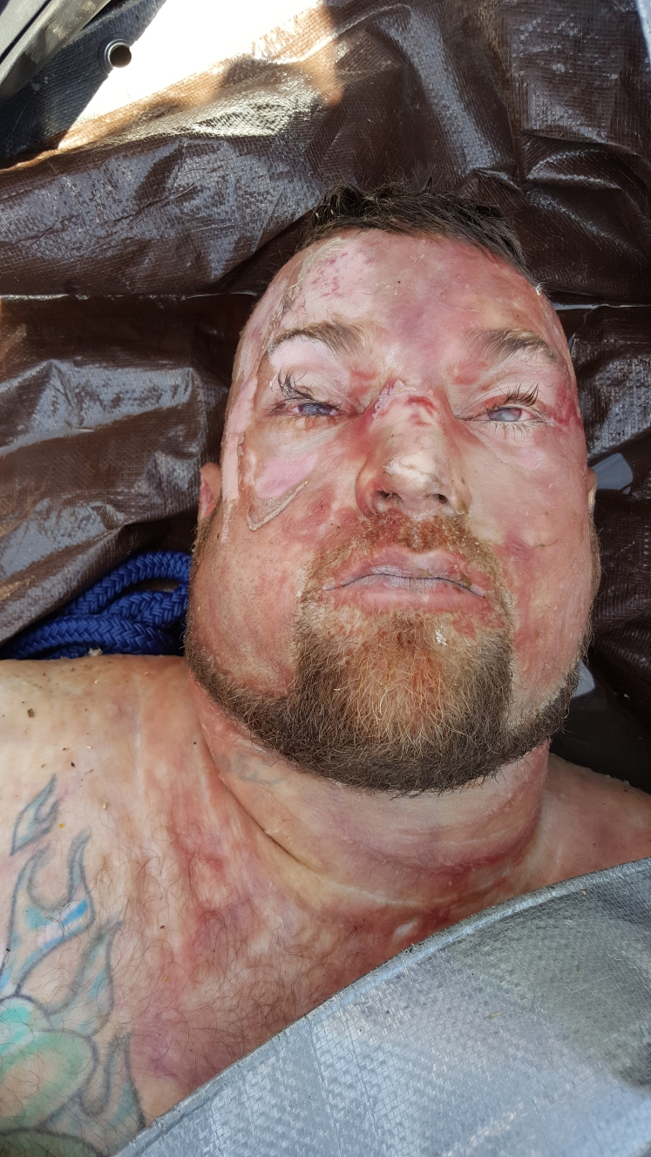
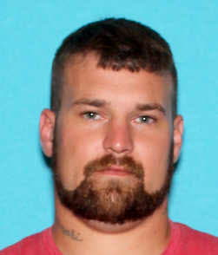
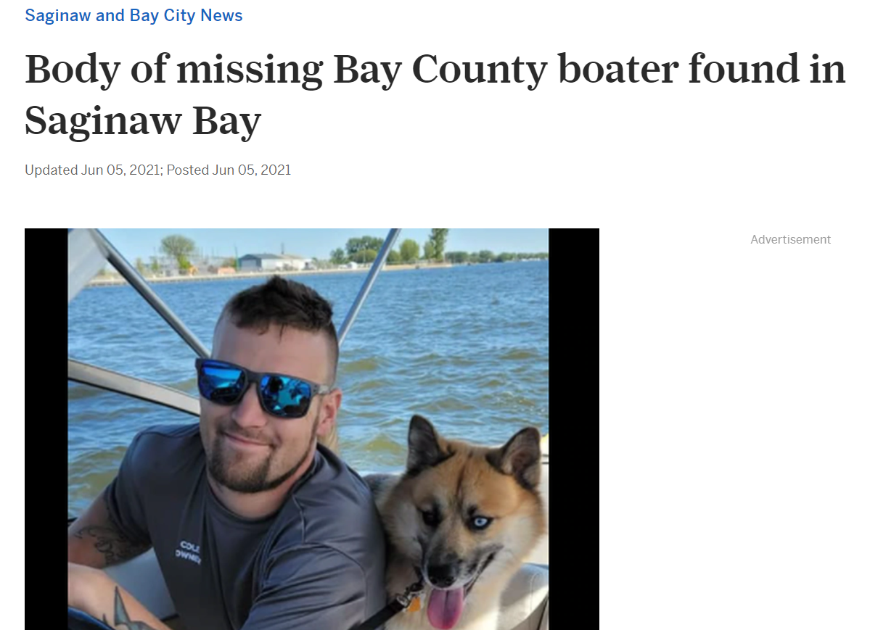
Lt. James Chlebowski
Bay County Sheriff's Office

Slide 26
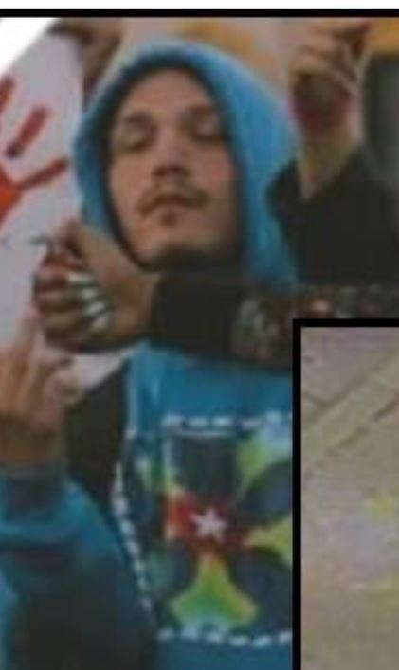
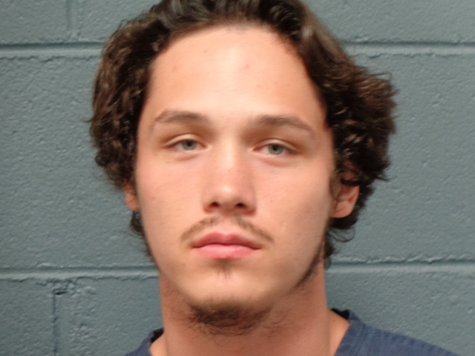
Malicious destruction of property suspect

Slide 27
Vulnerable or Impaired Persons Repository
In Michigan, MCL 722.774 and MCL 28.274 allow a parent/legal guardian/power of attorney of an individual with special needs to voluntarily provide the Vulnerable or Impaired Person’s (VIP’s) fingerprints and photograph for inclusion in SNAP.
A VIP’s fingerprints and photograph are stored along with additional demographic information, including the home address of the VIP and a contact person, email address, and phone number for the person legally responsible for the VIP.
The goal of the VIP program is to return VIPs to familiar, safe environments, while maintaining their dignity.
MSP-VIP@michigan.gov

Slide 28
Questions?
Notes:
The images in this database are considered highly restricted personal information by state and federal statute. Use and dissemination of driver's license photos and electronic signature files are for law enforcement purposes only. Misuse may result in user specific or agency wide loss of access.
By clicking OK to access the Case Management Facial Recognition Feature of the Michigan State Police's Statewide Network of Agency Photo's (SNAP) Program it is understood and agreed that any information derived by your agency from a facial recognition search to the SNAP Program and the Federal Bureau of Investigations Interstate Photo System Facial Recognition Pilot (IPSFRP) Project should be considered an INVESTIGATIVE LEAD ONLY. It should NOT be considered a positive identification and is NOT probable cause to arrest. All probe submissions should be for law enforcement purposes only

Slide 29
Digital Analysis and Identification(DAI) Section Contacts
SNAP Unit
Ms. Krystal Howard DAI Section Manager HowardK6@Michigan.gov Ms. Kelcy McArthur Digital Image Supervisor McArthurK1@Michigan.gov Ms. Jennifer Coulson Digital Image Specialist CoulsonJ@michigan.gov Ms. Brittany Prescott Digital Image Specialist PrescottB1@Michigan.gov
Request our services at:
SNAP: MSPSNAP@michigan.gov

